Slide 1
By: AnthonyBadalamenti and NickGregson

Slide 2
Name That Character
Name that song!!!!
STICKERS!
Spongebob Quotes.
Happy Wheels
100
100
100
100
100
200
200
200
200
200
300
300
300
300
300
400
400
400
400
400
500
500
500
500
500

Slide 3
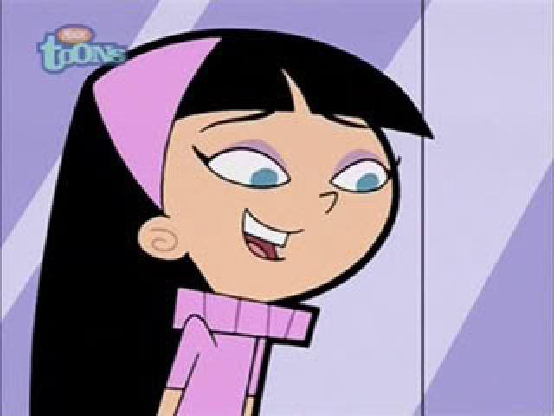
NAME THAT CHARACTER–100
Who is This Person?
Trixie Tang

Slide 4
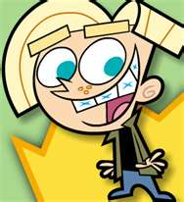
NAME THAT CHARACTER - 200
Name That Character First And Last Name..
CHESTER MCBADBAT!!

Slide 5
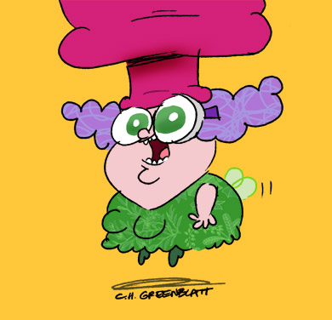
NAME THAT CHARACTER- 300
Who is This Character?
TRUFFLES!!

Slide 6
NAME THAT CHARACTER - 400
Who Is This Character?
Reggie Otto!!

Slide 7
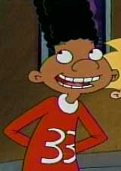
Subject 1 - 500
Who is This Character!!??
Gerald!!

Slide 8
Name That Song - 100
What is Tis This Song?
What is Not Afraid?
Mr.T says,”Hurry up you foo.”

Slide 9
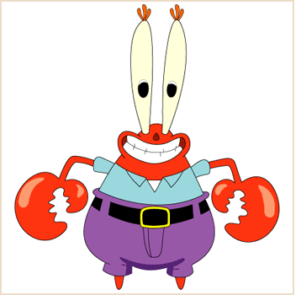
Name That Song - 200
What is Tis This Song?
What is Don’t Stop Believin?

Slide 10
Name That Song - 300
What is Tis Song?

Slide 11
Name That Song - 400
What is Tis Song?
What is Last Resort?

Slide 12
Name That Song - 500
What is Tis Song?
What is Shout 2000?
Did you get it? NO!!!

Slide 13
Spongebob Quotes – 100
Who says this: “Soap Soap What is Soap?”
SPONGEBOB!!!!

Slide 14
Spongebob Quotes - 200
Who Said This: “Did I? Did I Patrick? Or did your criminal mind hypnotize me into stealing the balloon
SPONGEBOB!!!!

Slide 15
SpongeBob Quotes - 300
Who said this “I smell the smelly smell of something that smells smelly.”
Mr. Krabs

Slide 16
Spongebob Quotes- 400
Who says this: “Next I suppose you’ll want me to go square-dancing with Partrick.”
SQUIADWARD!!!

Slide 17
SpongeBob Quotes - 500
Who said this: “You mean they’re taking the thoughts we think we thought and making them thoughts we think we though….. I think.”
PATRICK!!!

Slide 18
Funny City Names- 100
BANGKOK
Thailand!!!!

Slide 19
Funny City Names- 200
Bagdad
California

Slide 20
Funny City Names- 300
Hygiene
Colorado

Slide 21
Funny City Names- 400
KickaPoo
Illinois!!!

Slide 22
Funny City Names- 500
Mianus
Connecticut!!

Slide 23
Stickers!!!- 100
Fuzzy, Puffy, Not Sticker?
FUZZY!!!

Slide 24
Stickers!!!!- 200
Fuzzy, Puffy, Regular, or Not Sticker?
NOT A STICKER

Slide 25
Stickers!!!!- 300
Fuzzy, Puffy, Regular, or Not a Sticker
REGULAR!!!!!

Slide 26
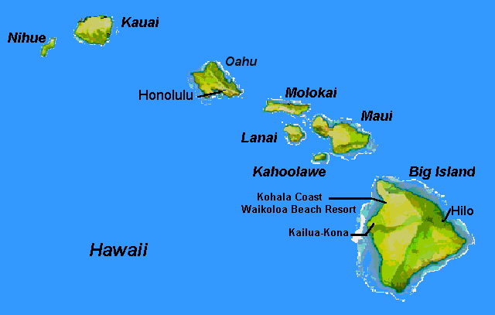
Stickers!!!!!!!- 400
Fuzzy, Puffy, Regular, Or Not a Sticker?
REGULAR STICKER!!!!~!

Slide 27
Stickers!!!!- 500
Fuzzy, Puffy, or Both? Or Not a Sticker
PUFFY!!!

Slide 28
Final Jeopardy!!

Slide 29
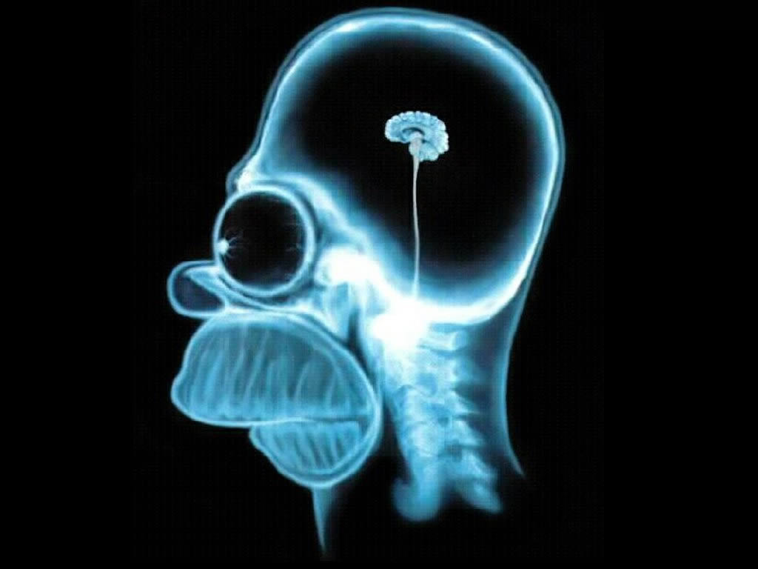
When is It Bad To Meet a White Cat?
Answer This Riddle
When You’re a Mouse

